Slide 1
Predicting NFL Game Outcomes

Slide 2
Outline
Summary
The Data
Cool Graphs / Analysis
Conclusions

Slide 3
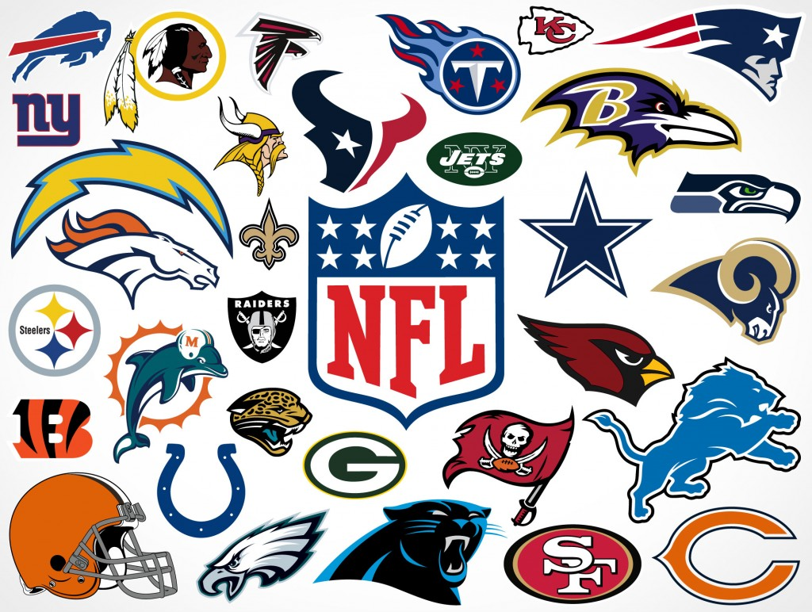
Summary
I would like to have a system that predicts the outcome of all the NFL games for the season
I will base my predictions on information about the previous 2 games for each team playing
I will also answer the question “Will the home team win?” based on the previous 2 games for each team playing
Notes:
In the mid to late 1980's, there was a big push to put a warning label on records and CD's that were deemed 'explicit' and had suggestive or 'satanic' lyrics. This was supposed to help parents monitor the music their children were buying. I propose it had the opposite effect. Albums and music with explicit lyrics and images were more popular after the mid to late 1980's.

Slide 4
The Data
NFL pro football reference game information from years 2000 - 2017
Odds - money line, open/close lines historic info
I merged these 2 files together for my analysis
Raw data available here:
https://www.pro-football-reference.com/years
http://www.aussportsbetting.com/historical data/nfl.xlsx
https://www.kaggle.com/tobycrabtree/nfl-scores-and-betting-data

Slide 5
Assumptions
The
Notes:
My determination of a single genre for each song is accurate

Slide 6
E
Notes:
My determination of a single genre for each song is accurate

Slide 7
Cool Graphs

Slide 8
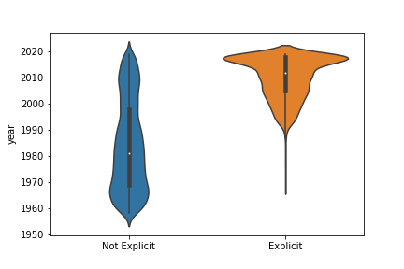

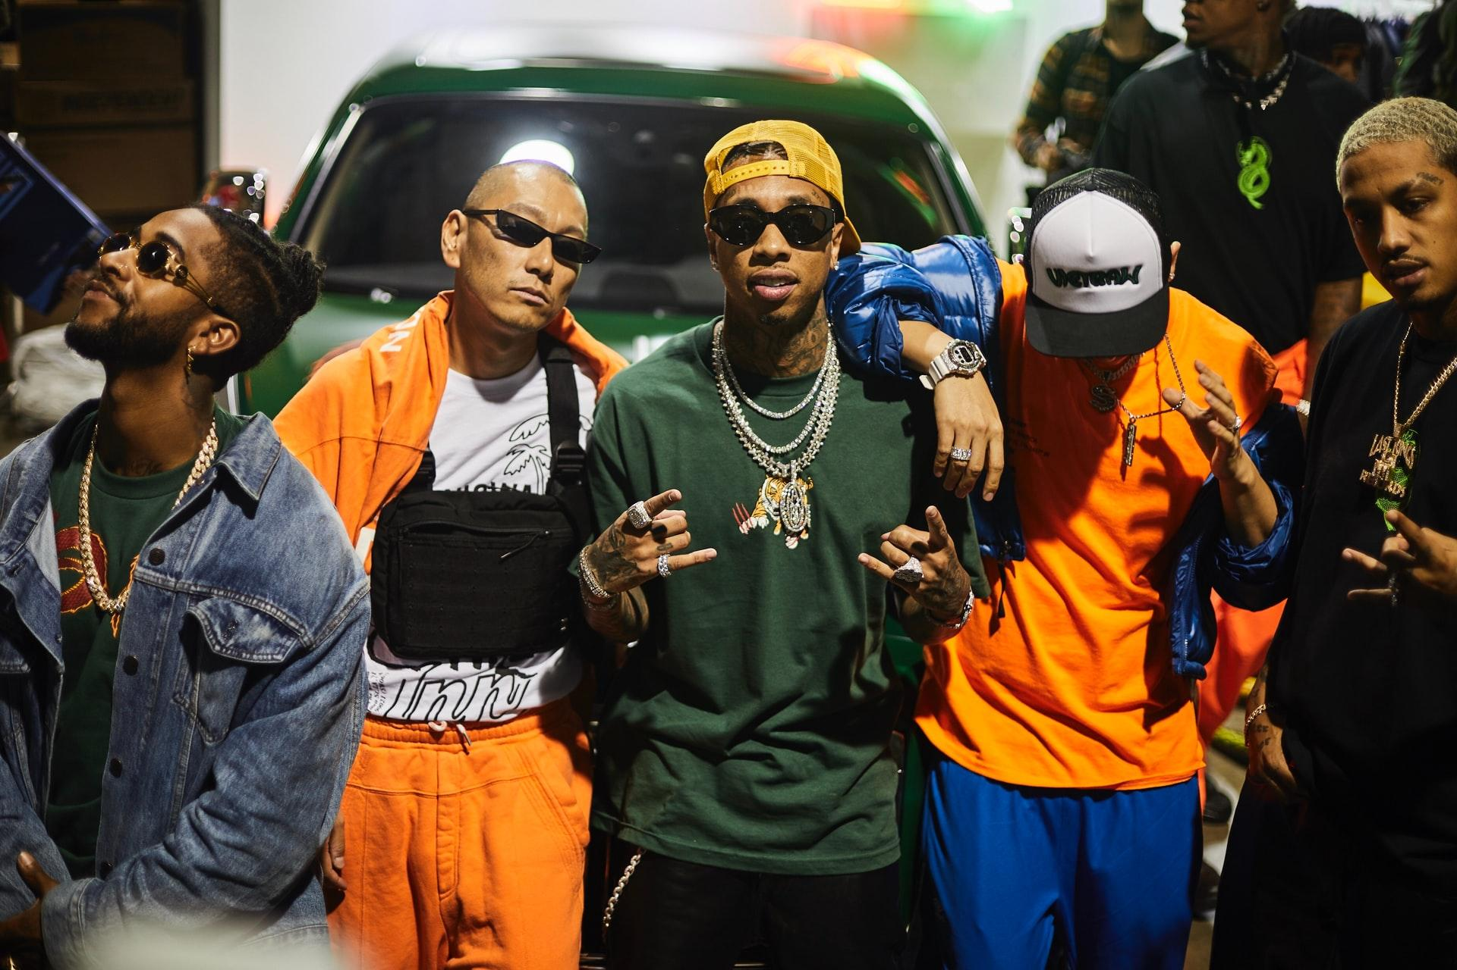
There were very few 'explicit' songs before 1985
vs.

Slide 9
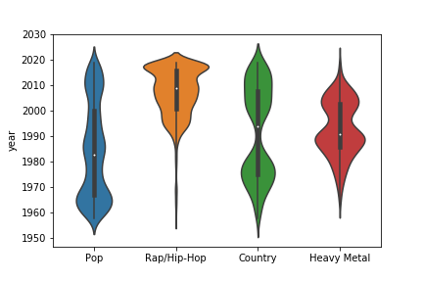

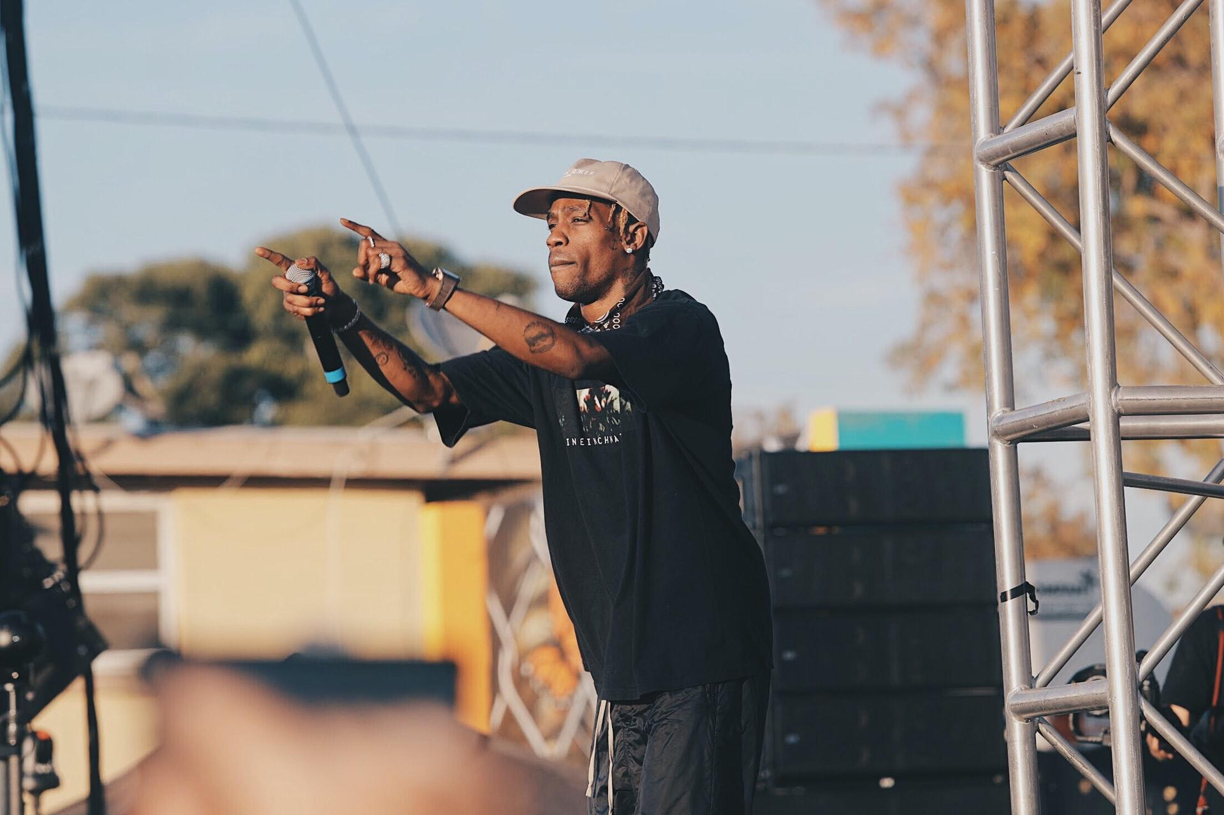


Rap and hip-hop became popular right after the PMRC was formed in 1985

Slide 10
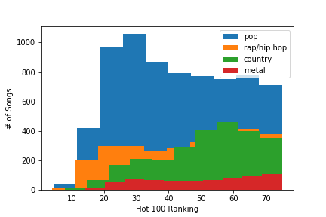
No significant difference in Hot 100 ranking between genres

Slide 11
The popularity of the songs in each of the genre groups by year was not normalized, so I used the Kruskal-Wallis and Mann-Whitney U tests to test my null hypothesis 1
The number of explicit vs not explicit songs by year was not normalized, so I used the Kruskal-Wallis and Mann-Whitney U tests to test my null hypothesis 2
Hot 100 lists - With 95% confidence, the popularity of rap, hip-hop and metal music increased dramatically after 1985, while pop and country stayed relatively steady
Spotify - With 95% confidence, explicit music as defined by Spotify became significantly more popular after 1985
Analysis Details

Slide 12
The stakeholders who would benefit from this research would be people who bet on NFL games, people who are in NFL fantasy football leagues and other NFL betting pool leagues.
It would give them insight into what is popular at a certain point in time.
Record label executives could sign performers and bands that make music that is more popular, and increase their profits
Band managers and performers could focus on more popular music to increase their profits as well
This research is very interesting to me because I love music and I am against the censorship of music. Seeing explicit music become more popular after an attempt on censorship is very satisfying.
Stakeholders

Slide 13
Explicit music became significantly more popular after the PMRC was formed in 1985
Rap and Hip-Hop are more explicit on average than other types of music, especially after 1985
Because explicit music is more popular after 1985, sales of explicit music have significantly increased since then
Conclusions

Slide 14
Questions?

